Slide 1



Slide 2


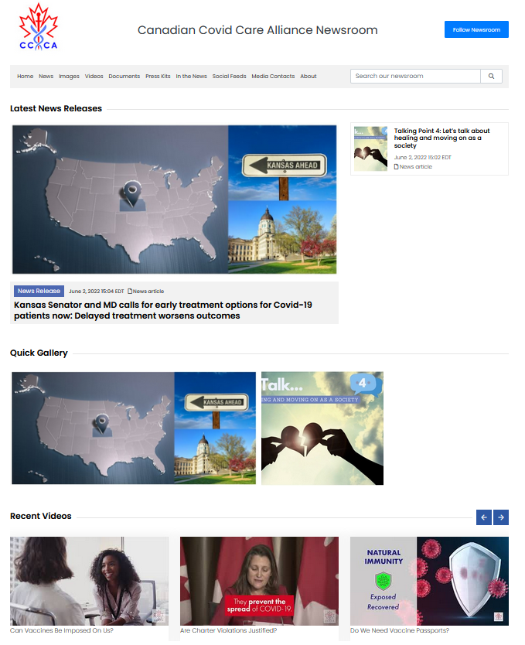
PR Karma Likes To Solve Problems
Our platform helps businesses & organizations with their communications and better reach their audiences, including the media.
PR Karma is great for those that find it difficult to reach the media with their news, like CCCA (Canadian Covid Care Alliance.)

Slide 3

Early Success From Past Experiences
Although PR Karma is relatively new, we have succeeded with our customers getting picked up by journalists, television, radio, and newspapers.
20+ years ago, sending a news release to a journalist was effective. People who were faxing news releases were very rooted in PR and you really needed to be in the industry to understand sending news releases. This experience came with quality news to journalists.

Slide 4

Garbage Content
Because of technology, sending news releases has become incredibly easy. Now it seems everyone can and does send them. Unfortunately, because it is so easy, the people sending them are not necessarily PR Professionals that understand good writing; it is anyone just sending information to journalists in 'hopes of a pickup.'
A lot of news sent is garbage, including pieces that are straight out blatant advertisements. On top of that, the costs to send a press release are pretty prohibitive, sometimes costing between $500 - $1000 for a single press release.

Slide 5

Journalists becoming numb.
Looking for other ways to attain their information.
What do all the poor-quality releases journalists are receiving translate to? First, it means journalists are becoming numb to the traditional press release and are looking for other ways to attain their information. Don't get me wrong, the press release isn't dead, and stories still get picked up, but many journalists are now turning to their research.

Slide 6

Professional Newsroom For All Your Media Assets
PR Karma solves this problem by providing you with an easy-to-use newsroom that is affordable for ANY business. (Ted. Would you agree with this?)

Slide 7








What Information Should Be In A Newsroom?
High-resolution images
Who your media contact is
A history of your business
About your business
Who are the key players of your Company (even if it is only one or two of you.)
Industry white papers or info
Where else you have been written up in the media
Any videos
Having your information readily available can mean the difference between a story and not having a story.

Slide 8

Increase chances of reaching
the media.
With a newsroom, you increase the chances of the media reaching out to you, or even better, following your news & information.
Rocky, a marriage counselor, received a call on Valentine's day from Check TV for an on-air interview. I said to him, "I didn't know you had sent any news out." His reply, "I didn't – They must have found me through my newsroom."
We know our service works as we've had a few clients having journalists sign up to follow their news. When they follow your newsroom, they choose how often they receive your information. Then, when you send the news to your followers, they receive the notification via email.

Slide 9
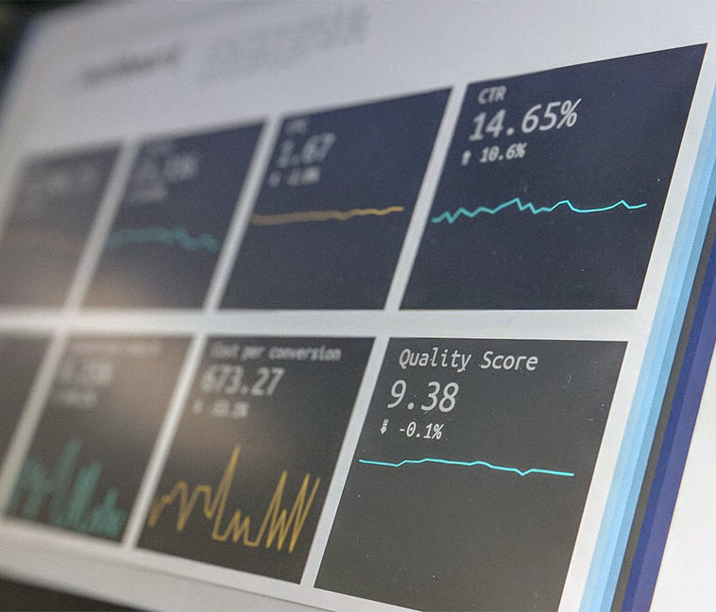
Statistics Show...
Statistics show that 75% of people check their email before social media when they wake up in the morning. On top of that, just posting on Social media is not enough. Why? Did you know that if you have 4,000 Facebook friends, only 5.25% of your friends will see your post? This low percentage is because FB is free. They want you to pay for advertising.
We believe in providing a product that will create a positive experience for journalists, increasing your chances of interacting with them—ultimately leading to a mainstream story.
After all this, you're probably wondering what our services cost? We are not afraid to show you – because it is affordable.

Slide 10

Does PR Karma Break the Bank?
Currently waiving our US $499 Setup Fee. We do your initial setup.
No contracts.
Month to month.
US $39/Mo. – Bronze package
COUPON CODE: ted39
(Offer expires June 15th)

Slide 11

Lets Zoom!
I’ve barely scratched the surface and would love to show you more.
Lets Zoom! See how easy it is to use!
REACH ME AT: Michael@prkarma.com
WEBSITE: PRKarma.com

Slide 12


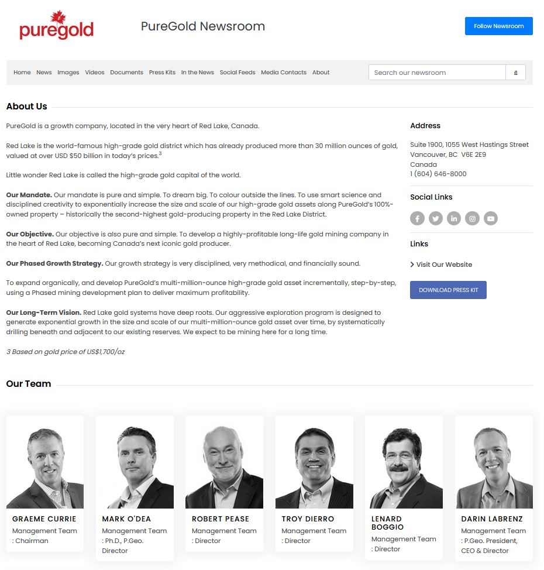
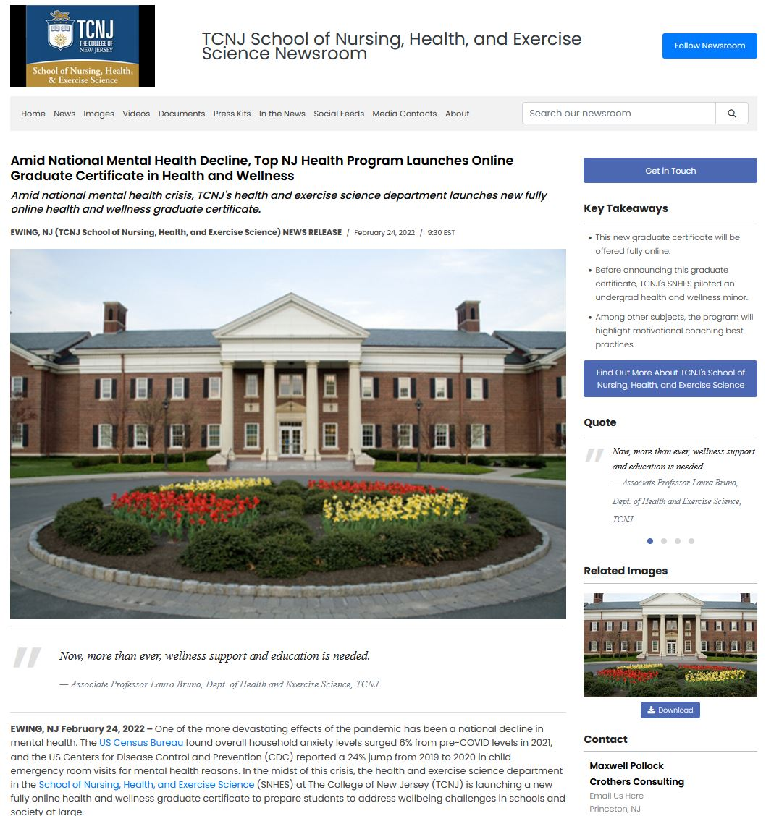

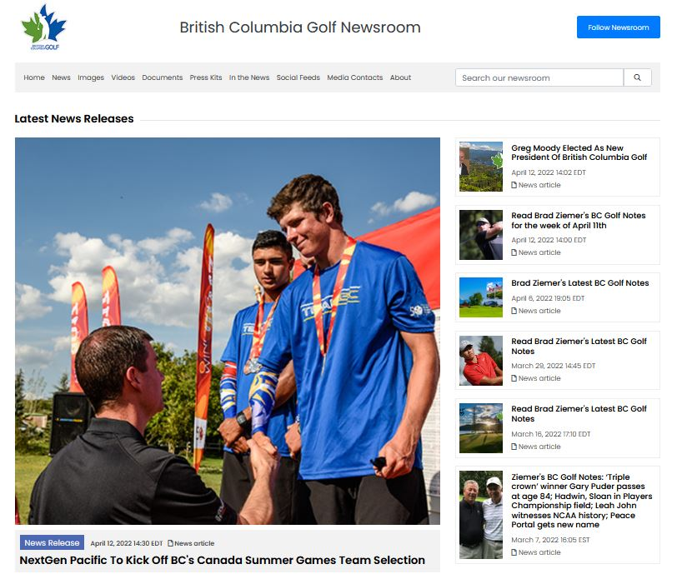

Slide 13

Thank You!
Thank you for taking time out of your day to learn a little more about how PR Karma can help you streamline your communications and better reach your customers and journalists.
Call us toll-free: (833) PR-KARMA or (833) 775-2762

